Slide 1

RETHINKING THE INTERFACE BETWEEN CIRCUITS, ARCHITECTURE, AND SYSTEMS
SOLVING THE
DRAM SCALING CHALLENGE:
Samira Khan

Slide 2

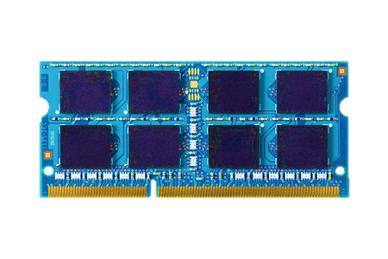

MEMORY IN TODAY’S SYSTEM
Processor
DRAM
Memory
Storage
DRAM is critical for performance

Slide 3
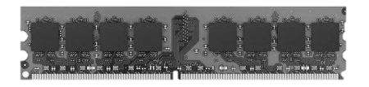
MAIN MEMORY CAPACITY
Gigabytes of DRAM
Increasing demand for high capacity
1. More cores
2. Data-intensive applications

Slide 4
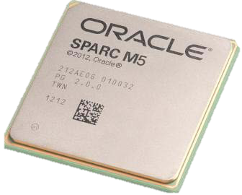
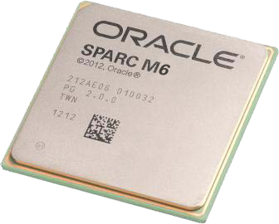
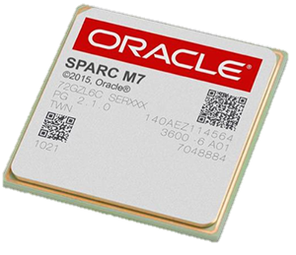

DEMAND 1:
INCREASING NUMBER OF CORES
2012
2013
2014
2015
SPARC M5
6 Cores
SPARC M6
12 Cores
SPARC M7
32 Cores
More cores need more memory

Slide 5




DEMAND 2:
DATA-INTENSIVE APPLICATIONS
MEMORY CACHING
IN-MEMORY DATABASE
More demand for memory

Slide 6
HOW DID WE GET MORE CAPACITY?
Technology
Scaling
DRAM Cells
DRAM Cells
DRAM scaling enabled high capacity

Slide 7
DRAM SCALING TREND
2X/1.5 YEARS
2X/3 YEARS
DRAM scaling is getting difficult
Source: Flash Memory Summit 2013, Memcon 2014

Slide 8
DRAM SCALING CHALLENGE
WHY?
Technology
Scaling
DRAM Cells
DRAM Cells
Manufacturing reliable cells at low cost
is getting difficult

Slide 9
In order to answer this we need to take a closer look to a DRAM cell
WHY IS IT DIFFICULT TO SCALE?
DRAM Cells

Slide 10
A DRAM cell
WHY IS IT DIFFICULT TO SCALE?
Transistor
Capacitor
Bitline
Bitline
Contact
Capacitor
Transistor
LOGICAL VIEW
VERTICAL CROSS SECTION

Slide 11
WHY IS IT DIFFICULT TO SCALE?
Technology
Scaling
DRAM Cells
DRAM Cells
Challenges in Scaling
1. Capacitor reliability
2. Cell-to-cell interference

Slide 12
SCALING CHALLENGE 1:
CAPACITOR RELIABILITY
Technology
Scaling
DRAM Cells
DRAM Cells
Capacitor is getting taller

Slide 13

CAPACITOR RELIABILITY
Height to Width Ratio 25
Height to Width Ratio
6
1.45 μm
828 m
3X nm CAPACITOR
BURJ KHALIFA
140 m
58 nm
Results in failures while manufacturing
Source: Flash Memory Summit, Hynix 2012

Slide 14
IMPLICATION:
DRAM COST TREND
PROJECTION
-33%/YEAR
-20%/YEAR
Cost is expected to go higher
Source: Flash Memory Summit, Hynix 2012

Slide 15

SCALING CHALLENGE 2:
CELL-TO-CELL INTERFERENCE
Technology
Scaling
Less Interference
More Interference
Indirect path
Indirect path
More interference results in
more failures

Slide 16
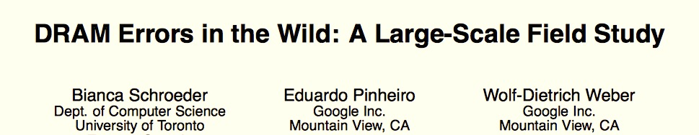
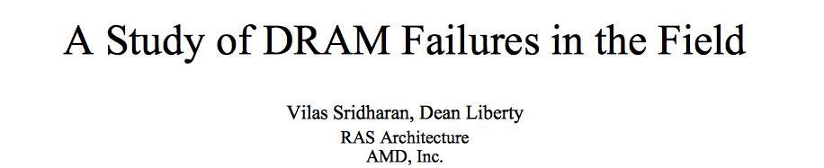
IMPLICATION:
DRAM ERRORS IN THE FIELD
1.52% of DRAM modules failed
in Google Servers
1.6% of DRAM modules failed
in LANL
SIGMETRICS’09, SC’12

Slide 17
GOAL
ENABLE
HIGH CAPACITY MEMORY
WITHOUT
SACRIFICING RELIABILITY

Slide 18

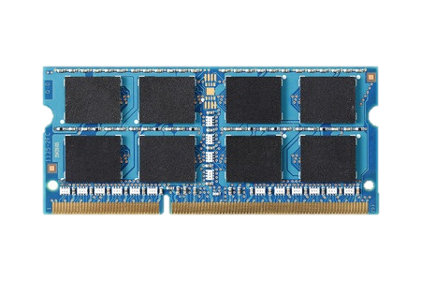
TWO DIRECTIONS
NEW
TECHNOLOGIES
DRAM
Difficult to scale
Predicted to be
highly scalable
MAKE DRAM SCALABLE
LEVERAGE NEW TECHNOLOGIES
SIGMETRICS’14, DSN’15, ONGOING
WEED’13, ONGOING

Slide 19



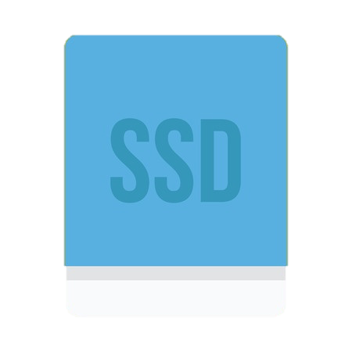

Technology
Scaling
DRAM Cells
DRAM Cells
DRAM SCALING CHALLENGE
Detect
and
Mitigate
UNIFY
Reliable
System
Non-Volatile
Memory
DRAM Cells
Storage
SYSTEM-LEVEL TECHNIQUES
TO ENABLE DRAM SCALING
NON-VOLATILE MEMORIES:
UNIFIED MEMORY & STORAGE
PAST AND FUTURE WORK

Slide 20
TRADITIONAL APPROACH
TO ENABLE DRAM SCALING
Make
DRAM
Reliable
Unreliable
DRAM Cells
Reliable
DRAM Cells
Reliable System
Manufacturing Time
System
in the Field
DRAM has strict reliability guarantee

Slide 21
MY APPROACH
Make
DRAM
Reliable
Unreliable
DRAM Cells
Reliable
DRAM Cells
Reliable System
Manufacturing Time
Manufacturing Time
System
in the Field
System
in the Field
Shift the responsibility to systems

Slide 22
VISION: SYSTEM-LEVEL DETECTION AND MITIGATION
Detect
and
Mitigate
Unreliable
DRAM Cells
Reliable System
Detect and mitigate errors after
the system has become operational
ONLINE PROFILING
Reduces cost, increases yield,
and enables scaling

Slide 23
CHALLENGE:
INTERMITTENT FAILURES
EFFICACY OF SYSTEM-LEVEL TECHNIQUES WITH REAL DRAM CHIPS
Detect
and
Mitigate
DRAM Cells
Reliable
System
SYSTEM-LEVEL TECHNIQUES
TO ENABLE DRAM SCALING
HIGH-LEVEL DESIGN
NEW SYSTEM-LEVEL TECHNIQUES

Slide 24
CHALLENGE: INTERMITTENT FAILURES
Detect
and
Mitigate
Unreliable
DRAM Cells
Reliable System
If failures were permanent, a simple
boot up test would have worked
What are the characteristics of intermittent failures?

Slide 25

DRAM RETENTION FAILURE
Switch
Refreshed
Every 64 ms
Leakage
Capacitor
Retention Time
Retention Time
Refresh Interval
64 ms
Time

Slide 26
INTERMITTENT RETENTION FAILURE
DRAM Cells
Some retention failures are intermittent
Two characteristics of intermittent retention failures
1
  Data Pattern Sensitivity
2
  Variable Retention Time

Slide 27
DATA PATTERN SENSITIVITY
NO
FAILURE
INTERFERENCE
FAILURE
0
0
0
1
1
Some cells can fail depending on the
data stored in neighboring cells
JSSC’88, MDTD’02
Notes:
Y. Nakagome, … Kiyoo Itoh, The Impact of Data-Line Interference Noise on DRAM Scaling, IJSSC’88
M. Redeker, B. F. Cockburn, and D. G. Elliott. An investigation into crosstalk noise in DRAM structures. MTDT, 2002 (Memory Technology, Design and Testing)
J. Liu et al. An experimental study of data retention behavior in modern DRAM devices: Implications for retention time profiling mechanisms, ISCA 2012

Slide 28
VARIABLE RETENTION TIME
Retention time changes randomly
in some cells
IEDM’87, IEDM’92
Notes:
D. S. Yaney, C. Y. Lu, R. A. Kohler, M. J. Kelly, and J. T. Nelson, A meta-stable leakage phenomenon in DRAM charge storage – Variable hold time, 1987 IEDM Tech.
Y. Mori et al. The origin of variable retention time in DRAM. IEDM, 2005.
P. J. Restle, J. W. Park, and B. F. Lloyd. DRAM variable retention time. IEDM, 1992.

Slide 29
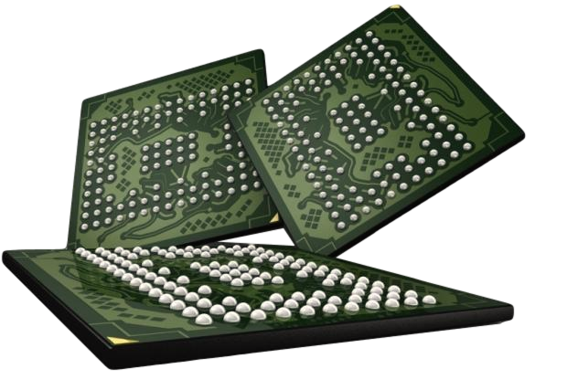
CURRENT APROACH TO CONTAIN INTERMITTENT FAILURES
Manufacturing Time Testing
PASS
FAIL
1. Manufacturers perform exhaustive testing of DRAM chips
2. Chips failing the tests are discarded

Slide 30
SCALING AFFECTING TESTING
Manufacturing Time Testing
PASS
FAIL
Longer Tests and More Failures
More interference in smaller technology nodes leads to lower yield and higher cost

Slide 31
SYSTEM-LEVEL ONLINE PROFILING
Not fully tested during
manufacture-time
Ship modules
with possible failures
2
1
PASS
FAIL
Detect and mitigate
failures online
3
Increases yield, reduces cost, enables scaling

Slide 32
CHALLENGE:
INTERMITTENT FAILURES
EFFICACY OF SYSTEM-LEVEL TECHNIQUES WITH REAL DRAM CHIPS
Detect
and
Mitigate
DRAM Cells
Reliable
System
SYSTEM-LEVEL TECHNIQUES
TO ENABLE DRAM SCALING
HIGH-LEVEL DESIGN
NEW SYSTEM-LEVEL TECHNIQUES

Slide 33
EFFICACY OF SYSTEM-LEVEL TECHNIQUES
Can we leverage existing techniques?
1
  Testing
WITHOUT REAL DATA ON
FAILURE RATE AND CHARACTERISTICS HARD TO ANALYZE
2
  Guardbanding
3
  Error Correcting Code
4
  Higher Strength ECC
We analyze the effectiveness of these techniques
using experimental data from real DRAMs
Data set publicly available

Slide 34
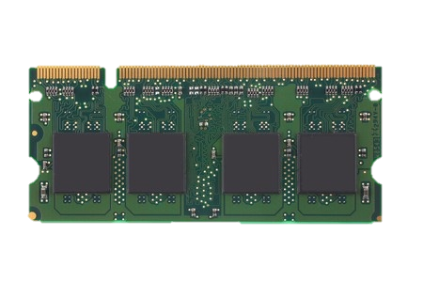
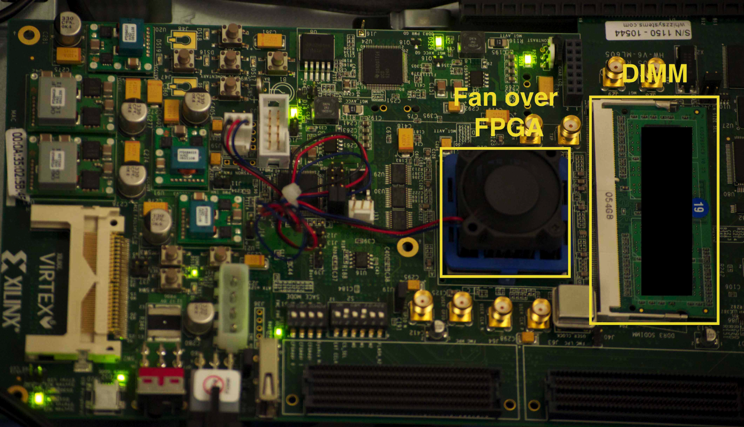
METHODOLOGY
FPGA-based testing infrastructure
Evaluated 96 chips from three major vendors

Slide 35
1. TESTING
Write some pattern
in the module
1
Repeat
3
2
Read
and verify
Wait until
refresh interval
Test each module with different patterns for many rounds
Zeros (0000), Ones (1111), Tens (1010), Fives (0101), Random

Slide 36
EFFICACY OF TESTING
Even after hundreds of rounds, a small number of new cells keep failing
Only a few rounds can discover most of the failures
Conclusion: Testing alone cannot detect
all possible failures

Slide 37
2. GUARDBANDING
Adding a safety-margin on the refresh interval
Can avoid VRT failures
4X Guardband
2X Guardband
Refresh Interval
Effectiveness depends on the
difference between retention times of a cell

Slide 38
EFFICACY OF GUARDBANDING

Slide 39
EFFICACY OF GUARDBANDING

Slide 40
EFFICACY OF GUARDBANDING

Slide 41
EFFICACY OF GUARDBANDING
Most of the cells exhibit closeby retention times

Slide 42
EFFICACY OF GUARDBANDING
There are few cells with large differences in retention times
Conclusion: Even a large guardband (5X) cannot detect 5-15% of the failing cells

Slide 43
3. ERROR CORRECTING CODE
Error Correcting Code (ECC)
  Additional information to detect error and correct data
ECC

Slide 44
EFFECTIVENESS OF ECC

Slide 45
EFFECTIVENESS OF ECC

Slide 46
EFFECTIVENESS OF ECC

Slide 47
EFFECTIVENESS OF ECC
Combination of techniques
reduces error rate by 10⁷ times
SECDED code reduces error rate by 100 times
Adding a 2X guardband reduces error rate
by 1000 times
Conclusion: A combination of mitigation techniques is much more effective

Slide 48
4. HIGHER STRENGTH ECC (HI-ECC)
No testing, use strong ECC
But amortize cost of ECC over larger data chunk
5EC6ED
Can potentially tolerate errors at the cost of higher strength ECC
Notes:
ECC needs t*ceil(log(k+ 1)) bits to correct t -bit errors in a k -bit input data
and one more bit to detect t + 1 bit errors.
8B SECDED: 7 + 1 bits
1KB SECDED: 13+1 bits

Slide 49
EFFICACY OF HI-ECC
10 Years

Slide 50
EFFICACY OF HI-ECC
10 Years

Slide 51
EFFICACY OF HI-ECC
After starting with 4EC5ED,
can reduce to 3EC4ED code
after 2 rounds of tests
10 Years

Slide 52
EFFICACY OF HI-ECC
Can reduce to DECTED code
after 10 rounds of tests
10 Years

Slide 53
EFFICACY OF HI-ECC
Can reduce to SECDED code, after 7000 rounds of tests
(4 hours)
10 Years
Conclusion: Testing can help to reduce the ECC strength, but blocks memory for hours

Slide 54
CONCLUSIONS SO FAR
Key Observations:
Testing alone cannot detect all possible failures
Combination of ECC and other mitigation techniques is much more effective
Testing can help to reduce the ECC strength
  Even when starting with a higher strength ECC
  But degrades performance

Slide 55
CHALLENGE:
INTERMITTENT FAILURES
EFFICACY OF SYSTEM-LEVEL TECHNIQUES WITH REAL DRAM CHIPS
Detect
and
Mitigate
DRAM Cells
Reliable
System
SYSTEM-LEVEL TECHNIQUES
TO ENABLE DRAM SCALING
HIGH-LEVEL DESIGN
NEW SYSTEM-LEVEL TECHNIQUES

Slide 56
TOWARDS AN
ONLINE PROFILING SYSTEM
Initially Protect DRAM
with Strong ECC
Periodically Test
Parts of DRAM
2
1
Test
ECC
Test
Test
Mitigate errors and
reduce ECC
3
Run tests periodically after a short interval
at smaller regions of memory

Slide 57
CHALLENGE:
INTERMITTENT FAILURES
EFFICACY OF SYSTEM-LEVEL TECHNIQUES WITH REAL DRAM CHIPS
Detect
and
Mitigate
DRAM Cells
Reliable
System
SYSTEM-LEVEL TECHNIQUES
TO ENABLE DRAM SCALING
HIGH-LEVEL DESIGN
NEW SYSTEM-LEVEL TECHNIQUES

Slide 58
WHY SO MANY ROUNDS OF TESTS?
DATA-DEPENDENT FAILURE
Fails when specific pattern in the neighboring cell
L
0
R
D
0
1
LINEAR
ADDRESS
X-1
X
X+1
0
0
1
0
0
1
SCRAMBLED
ADDRESS
X-1
X-4
X
X+2
X+1
Even many rounds of random patterns
cannot detect all failures

Slide 59
DETERMINE THE LOCATION OF PHYSICALLY ADJACENT CELLS
L
D
R
SCRAMBLED
ADDRESS
X-?
X
X+?
NAÏVE SOLUTION
For a given failure X,
test every combination of two bit addresses in the row
O(n²)
8192*8192 tests, 49 days for a row with 8K cells
Our goal is to reduce the test time

Slide 60
STRONGLY VS. WEAKLY DEPENDENT CELLS
STRONGLY DEPENDENT
Fails even if only one neighbor data changes
WEAKLY DEPENDENT
Fails if both neighbor data change
Can detect neighbor location in strongly dependent cells by testing every bit address
0, 1, … , X, X+1, X+2, … n

Slide 61
PHYSICAL NEIGHBOR LOCATION TEST
Testing every bit address will
detect only one neighbor
Run parallel tests in different rows
X-4
L
A
L
C
R
B
R
X+2
Aggregate the locations from different rows

Slide 62
PHYSICAL NEIGHBOR LOCATION TEST
L
A
X-4
X
SCRAMBLED
ADDRESS
2
6
LINEAR
TESTING
0 1 2 3 4 5 6 7
RECURSIVE
TESTING
0, 1, 2, 3
4, 5, 6, 7
0, 1
2, 3
4, 5
6, 7
0
1
2
3
4
5
6
7

Slide 63
PHYSICAL NEIGHBOR-AWARE TEST
A
B
C
NUM TEST
REDUCED
745654X
1016800X
745654X
EXTRA FAILURES
27%
11%
14%
Detects more failures
with small number of tests
leveraging neighboring information

Slide 64
NEW SYSTEM-LEVEL TECHNIQUES
REDUCE FAILURE MITIGATION OVERHEAD
Mitigation for worst vs. common case
Reduces mitigation cost around 3X-10X
ONGOING
Variable refresh
Leverages adaptive refresh to mitigate failures
DSN’15

Slide 65
SUMMARY
Detect
and
Mitigate
Unreliable
DRAM Cells
Reliable System
Proposed online profiling to enable scaling
Analyzed efficacy of system-level detection and mitigation techniques
Found that combination of techniques is much more effective, but blocks memory
Proposed new system-level techniques to reduce detection and mitigation overhead

Slide 66
Technology
Scaling
DRAM Cells
DRAM Cells
DRAM SCALING CHALLENGE
Detect
and
Mitigate
UNIFY
Reliable
System
Non-Volatile
Memory
DRAM Cells
Storage
SYSTEM-LEVEL TECHNIQUES
TO ENABLE DRAM SCALING
NON-VOLATILE MEMORIES:
UNIFIED MEMORY & STORAGE
PAST AND FUTURE WORK

Slide 67
TWO-LEVEL STORAGE MODEL
CPU
Ld/St
VOLATILE
MEMORY
FAST
DRAM
BYTE ADDR
FILE
I/O
STORAGE
NONVOLATILE
SLOW
BLOCK ADDR

Slide 68
TWO-LEVEL STORAGE MODEL
CPU
Ld/St
VOLATILE
MEMORY
FAST
DRAM
BYTE ADDR
FILE
I/O
NVM
STORAGE
PCM, STT-RAM
NONVOLATILE
SLOW
BLOCK ADDR
Non-volatile memories combine characteristics of memory and storage

Slide 69
VISION: UNIFY MEMORY AND STORAGE
CPU
Ld/St
PERSISTENTMEMORY
NVM
Provides an opportunity to manipulate persistent data directly

Slide 70
DRAM IS STILL FASTER
CPU
CPU
Ld/St
PERSISTENTMEMORY
MEMORY
DRAM
NVM
A hybrid unified
memory-storage system

Slide 71


CHALLENGE: DATA CONSISTENCY
CPU
CPU
Ld/St
PERSISTENTMEMORY
MEMORY
System crash can result in
permanent data corruption in NVM

Slide 72
CURRENT SOLUTIONS
Explicit interfaces to manage consistency
  NV-Heaps [ASPLOS’11], BPFS [SOSP’09], Mnemosyne [ASPLOS’11]
AtomicBegin {
Insert a new node;
} AtomicEnd;
Limits adoption of NVM
Have to rewrite code with clear partition
between volatile and non-volatile
Burden on the programmers

Slide 73
OUR GOAL AND APPROACH
Goal:
Provide efficient transparent consistency in hybrid systems
time
Running
Checkpointing
Running
Checkpointing
Epoch 0
Epoch 1
Periodic Checkpointing of dirty data
Transparent to application and system
Hardware checkpoints and recovers data

Slide 74
CHECKPOINTING GRANULARITY
PAGE
DIRTY CACHE
BLOCK
EXTRA WRITES
SMALL METADATA
NO EXTRA WRITE
HUGE METADATA
DRAM
NVM
High write locality pages in DRAM,
low write locality pages in NVM

Slide 75
DUAL GRANULARITY CHECKPOINTING
DRAM
NVM
GOOD FOR
STREAMING WRITES
GOOD FOR
RANDOM WRITES
Can adapt to access patterns

Slide 76
TRANSPARENT DATA CONSISTENCY
Cost of consistency compared to systems with zero-cost consistency
DRAM
NVM
UNMODIFIED
LEGACY
CODE
-3.5%
+2.7%
Provides consistency without
significant performance overhead

Slide 77
Technology
Scaling
DRAM Cells
DRAM Cells
DRAM SCALING CHALLENGE
Detect
and
Mitigate
UNIFY
Reliable
System
Non-Volatile
Memory
DRAM Cells
Storage
SYSTEM-LEVEL TECHNIQUES
TO ENABLE DRAM SCALING
NON-VOLATILE MEMORIES:
UNIFIED MEMORY & STORAGE
PAST AND FUTURE WORK

Slide 78
OTHER WORK
IMPROVING CACHE PERFORMANCE
MICRO’10, PACT’10, ISCA’12, HPCA’12, HPCA’14
CPU
EFFICIENT LOW VOLTAGE PROCESSOR OPERATION
HPCA’13, INTEL TECH JOURNAL’14
MEMORY
NEW DRAM ARCHITECTURE
HPCA’15, ONGOING
STORAGE
ENABLING DRAM SCALING
SIGMETRICS’14, DSN’15, ONGOING
UNIFYING MEMORY & STORAGE
WEED’13, ONGOING

Slide 79
FUTURE WORK: TRENDS
CPU
MEMORY
DRAM
NVM
LOGIC
STORAGE

Slide 80
APPROACH
DESIGN AND BUILD BETTER SYSTEMS
WITH NEW CAPABILITIES
BY REDEFINING FUNCTIONALITIES ACROSS DIFFERENT LAYERS
IN THE SYSTEM STACK

Slide 81


RETHINKING STORAGE
APPLICATION
OPERATING SYSTEM
SSD
CPU
FLASH
CONTROLLER
FLASH
CHIPS
APPLICATION, OPERATING SYSTEM, DEVICES
What is the best way to design a system
to take advantage of the SSDs?

Slide 82
ENHANCING SYSTEMS WITH
NON-VOLATILE MEMORY
Recover
and
migrate
NVM
PROCESSOR, FILE SYSTEM,
DEVICE, NETWORK, MEMORY
How to provide efficient instantaneous system recovery and migration?

Slide 83
DESIGNING SYSTEMS WITH MEMORY
AS AN ACCELERATOR
MANAGE
DATA
FLOW
SPECIALIZED CORES
MEMORY WITH LOGIC
APPLICATION, PROCESSOR, MEMORY
How to manage data movement when applications run on different accelerators?

Slide 84
THANK YOU
QUESTIONS?

Slide 85
RETHINKING THE INTERFACE BETWEEN CIRCUITS, ARCHITECTURE, AND SYSTEMS
SOLVING THE
DRAM SCALING CHALLENGE:
Samira Khan

