Slide 1
Improving the Reliability of Chip-Off Forensic Analysis of NAND Flash Memory Devices
Aya Fukami, Saugata Ghose, Yixin Luo, Yu Cai, Onur Mutlu

Slide 2
Brief Summary of the Paper
Our Goal:
Identify error sources in NAND flash memory during chip-off
Quantify errors in NAND flash memory introduced in chip-off
Identify a mitigation process to reduce errors introduced during chip-off analysis
Our findings:
Long storage time of devices increases errors in NAND flash memory
Heat in chip-off increases uncorrectable errors
Read-retry mechanism can reduce errors introduced during chip-off

Slide 3
Talk Outline
Background
Basic operation of NAND flash memory
Testing Methodology and Experimental Results
Retention error
Errors introduced by heat
How to Improve Reliability of Chip-off Analysis
Read-retry operation

Slide 4
Talk Outline
Background
Basic operation of NAND flash memory
Testing Methodology and Experimental Results
Retention error
Errors introduced by heat
How to Improve Reliability of Chip-off Analysis
Read-retry operation

Slide 5
MLC NAND Flash Memory Cell Operation
Control Gate
Floating
Gate
Oxide
Source
Substrate
–
–
–
Drain
–
–
–
–
–
–
–
–
–
–
–
–
–
–
–
–
–
–
–
–
–
–
–
–
–
–
–
–
–
–
–
–
–
Stored data: 11
01
00
10
Current[A]
Threshold voltage
Voltage[V]
Amount of charge = Threshold voltage of the cell = Stored data value

Slide 6
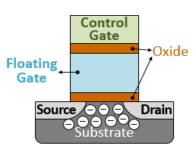
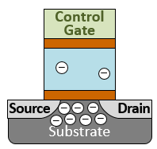
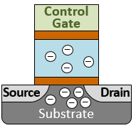
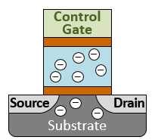
MLC NAND Cell Vth Distribution
Read voltage
11
01
00
10
Number of cells
Threshold Voltage
Threshold voltages need to be between each read voltage

Slide 7
Retention Error on MLC NAND Flash Cell
Control Gate
Floating
Gate
Oxide
–
–
–
–
–
–
–
–
–
–
–
–
Source
Substrate
–
–
–
Drain
–
–
–
–
–
–
–
–
–
–
–
–
–
–
–
–
–
–
–
–
–
Read voltage
11
01
00
10
Number of cells
Error!
Error!
Error!
Threshold Voltage
Charge leakage over time causes threshold voltage shifts
Data error in result is called retention error

Slide 8
NAND Flash Cell Degradation
Oxide
–
–
–
–
–
–
–
–
–
–
–
–
–
–
–
–
–
–
–
–
–
–
–
–
–
–
–
Programming
Erasing
Degraded Cell
00
10
Number of cells
Error!
Threshold Voltage
Repeated programming and erasing (P/E cycle) accelerates charge leakage

Slide 9
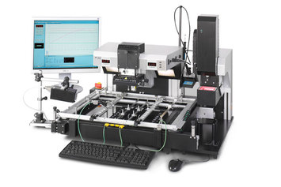
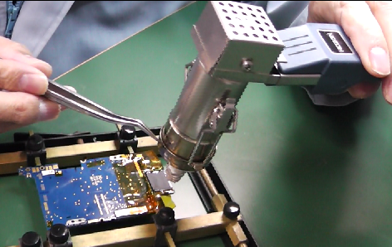
NAND Flash Error Sources During Chip-off
Heat guns or electrical rework machines
De-solder NAND flash memory chips with heat
Required temperature and duration:
250 °C (482 °F), ~2 minutes
High temperature accelerates charge leakage

Slide 10
Error Correction Codes (ECC)
Flash memory controllers store ECC codewords to correct errors in data
Typical correction capability for recent chip: 40 bits correction capability per 1KB
Errors exceeding ECC correction capability: uncorrectable errors

Slide 11
Talk Outline
Background
Basic operation of NAND flash memory
Testing Methodology and Experimental Results
Retention error
Errors introduced by heat
How to Improve Reliability of Chip-off Analysis
Read-retry operation

Slide 12
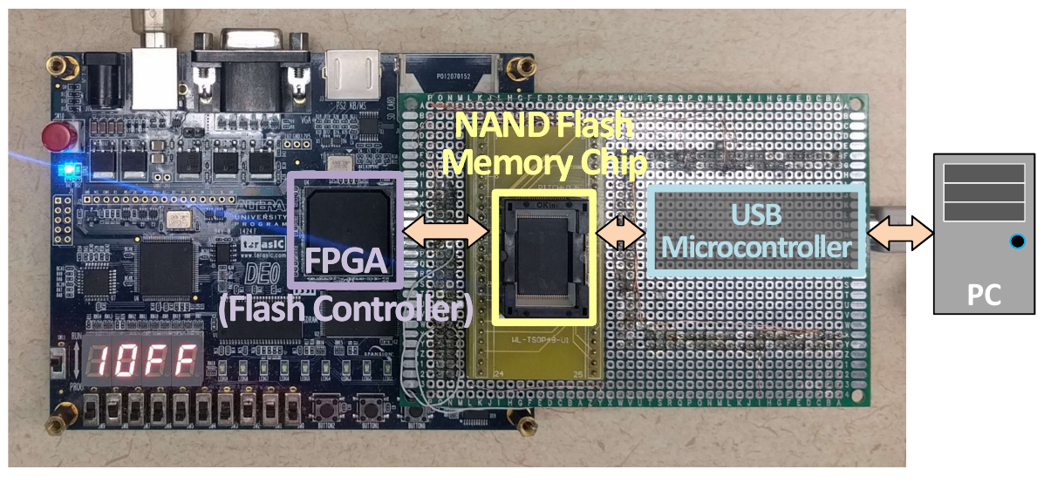
Testing Environment
Test chips: New 2y-nm NAND flash memory chips from two different vendors (hereafter called Chip A and Chip B)
Controller: Altera DE0 FPGA

Slide 13
Testing Methodology: Retention Error Evaluation
Repeated programming/erasing cycles (P/E cycles)
10, 300, 1000, 2500, and 4000 cycles
Raw bit error rate (RBER) measurement at multiple retention age (=wait time after programming)
Day 0 and 1, Week 1, 2, 3 and 4

Slide 14
Experimental Result: Retention Error: Chip A
10⁻²
10⁻³
10⁻⁴
10⁻⁵
ECC Error Correction Capability
18×
12×
RBER grows as P/E cycle count and retention age increase

Slide 15
Experimental Result: Retention Error: Chip B
10⁻²
10⁻³
10⁻⁴
10⁻⁵
ECC Error Correction Capability
4×
3×
RBER grows as P/E cycle count and retention age increase

Slide 16
Testing Methodology: Thermal Effect Evaluation
Baking target chips at 250 °C for 2 mins at different retention age (simulating chip-off procedures)
1 Week
4 Weeks
Raw bit error rate (RBER) measurement after baking

Slide 17
Experimental Result: Errors Introduced by Heat (Chip A)
10⁰
10⁻¹
10⁻²
10⁻³
10⁻⁴
10⁻⁵
ECC Error Correction
Capability
51×
33×
Heat introduces errors more than ECC can correct

Slide 18
Experimental Result: Errors Introduced by Heat (Chip B)
10⁰
10⁻¹
10⁻²
10⁻³
10⁻⁴
10⁻⁵
ECC Error Correction Capability
37×
51x
Heat introduces errors more than ECC can correct

Slide 19
Experimental Result: Uncorrectable Errors after Baking
Fraction of pages that contains uncorrectable errors (P/E cycle=300)
Retention Period before Baking | Chip A | Chip B
1 Week | 29.1% | 78.1%
4 Weeks | 84.2% | 83.6%
Heat introduces uncorrectable errors
even when the chip has been only lightly used

Slide 20
Talk Outline
Background
Basic operation of NAND flash memory
Testing Methodology and Experimental Results
Retention error
Errors introduced by heat
How to Improve Reliability of Chip-off Analysis
Read-retry operation

Slide 21
Read-Retry Mechanism
Default read voltage
Shifted read voltage
Shifted read voltage
11
01
Number of cells
01 → 11
01 → 11
Threshold Voltage
Read-retry mechanism shifts the read voltage
to reduce errors caused by threshold voltage shifts

Slide 22
Testing Methodology: Read-Retry Evaluation
Read-Retry command found on chip B
Implemented as a vendor specific command
Read operation with read-retry
Evaluation of 2 modes (mode A and B)

Slide 23
Experimental Result: Error Reduction with Read-Retry
10⁻¹
10⁻²
10⁻³
10⁻⁴
-94.6%
ECC Error Correction Capability
-88.6%
Read-retry can reduce errors introduced
by thermal-based chip-off procedure

Slide 24
Uncorrectable Error Reduction by Read-Retry
Fraction of pages that contains uncorrectable errors (Chip B, after baking)
Read Mode | P/E Cycle Count
 | 300 | 1000
Default | 83.6% | 99.7%
Read-Retry A | 0% | 12.1%
Read-Retry B | 0% | 0%
Read-retry can reduce errors introduced
by thermal-based chip-off procedure

Slide 25
Conclusions and Recommendations
Wait time increases errors
Conduct data extraction at the earliest possible time after receiving a device
Heat introduces uncorrectable errors
Keep the temperature as low as possible
Read-retry can reduce errors
Use read-retry after chip-off when available

Slide 26
Improving the Reliability of Chip-Off Forensic Analysis of NAND Flash Memory Devices
Aya Fukami, Saugata Ghose, Yixin Luo, Yu Cai, Onur Mutlu

Slide 27
Additional Slides

Slide 28
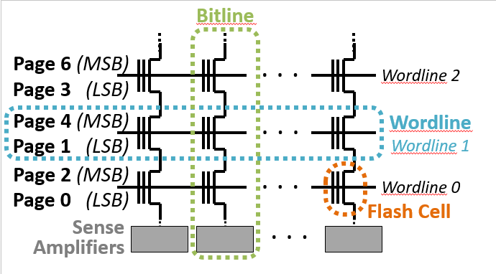
NAND Flash Memory Organization

Slide 29
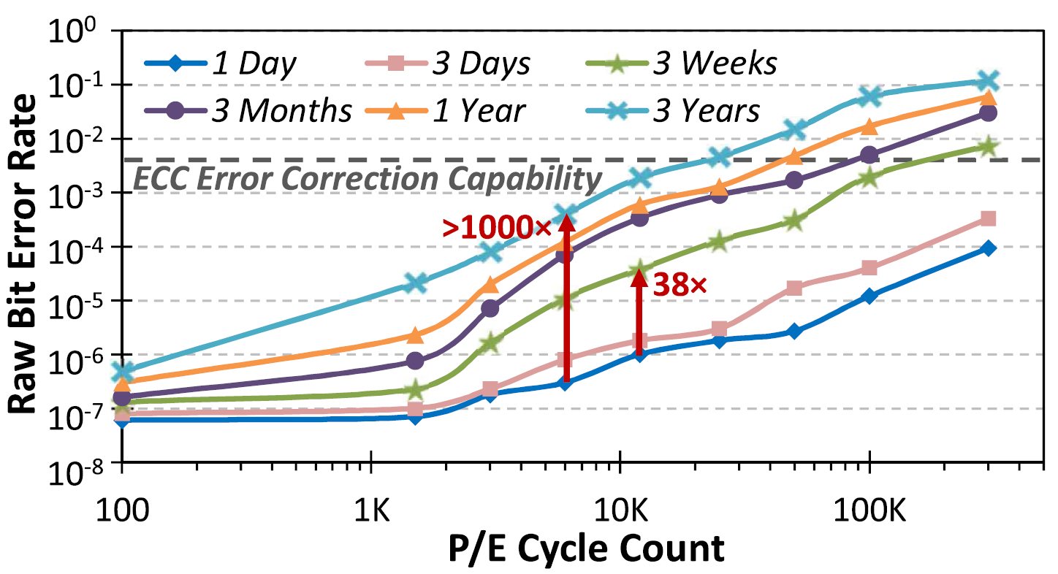
Retention Error over P/E Cycles
Reproduced from Cai.et.al. “Error Patterns in MLC NAND Flash Memory: Measurement, Characterization, and Analysis” (2012)

Slide 30
