Slide 1



Understanding Reduced-Voltage Operation in Modern DRAM Devices
Experimental Characterization, Analysis, and Mechanisms
Kevin Chang†
A. Giray Yaglikci†, Saugata Ghose†, Aditya Agrawal*, Niladrish Chatterjee*,
Abhijith Kashyap†, Donghyuk Lee*, Mike O’Connor*, Hasan Hassan‡, Onur Mutlu†‡
†
*
‡

Slide 2
Executive Summary
DRAM (memory) power is significant in today’s systems
  Existing low-voltage DRAM reduces voltage conservatively
Goal: Understand and exploit the reliability and latency behavior of real DRAM chips under aggressive reduced-voltage operation
Key experimental observations:
  Errors occur and increase with lower voltage
  Errors exhibit spatial locality
  Higher operation latency mitigates voltage-induced errors
Voltron: A new DRAM energy reduction mechanism
  Reduce DRAM voltage without introducing errors
  Use a regression model to select voltage that does not degrade performance beyond a chosen target → 7.3% system energy reduction

Slide 3
Outline
Executive Summary
Motivation
DRAM Background
Characterization of DRAM
Voltron: DRAM Energy Reduction Mechanism
Conclusion

Slide 4

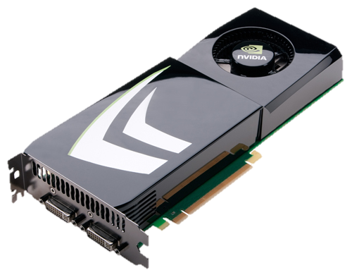
High DRAM Power Consumption
Problem: High DRAM (memory) power in today’s systems
>40% in POWER7 (Ware+, HPCA’10)
  >40% in GPU (Paul+, ISCA’15)

Slide 5
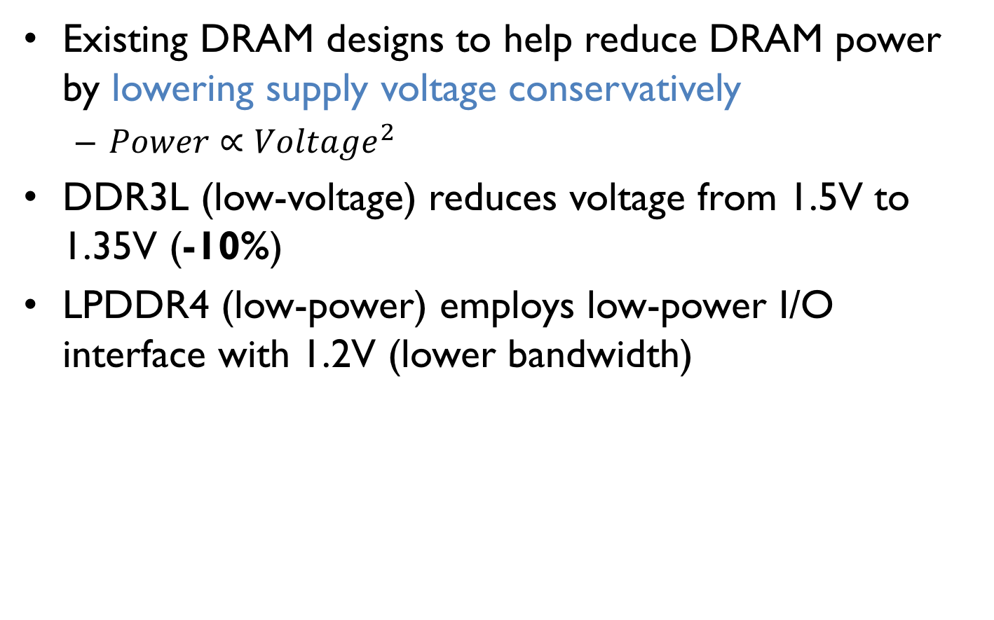
Low-Voltage Memory
Existing DRAM designs to help reduce DRAM power by lowering supply voltage conservatively
  $Power∝{Voltage}^{2}$
DDR3L (low-voltage) reduces voltage from 1.5V to 1.35V (-10%)
LPDDR4 (low-power) employs low-power I/O interface with 1.2V (lower bandwidth)
Can we reduce DRAM power and energy by further reducing supply voltage?

Slide 6
Goals
1 Understand and characterize the various characteristics of DRAM under reduced voltage
2 Develop a mechanism that reduces DRAM energy by lowering voltage while keeping performance loss within a target

Slide 7
Key Questions
How does reducing voltage affect reliability (errors)?
How does reducing voltage affect
DRAM latency?
How do we design a new DRAM energy reduction mechanism?

Slide 8
Outline
Executive Summary
Motivation
DRAM Background
Characterization of DRAM
Voltron: DRAM Energy Reduction Mechanism
Conclusion

Slide 9
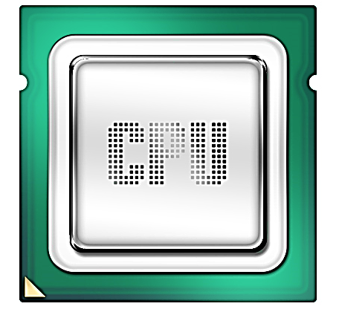
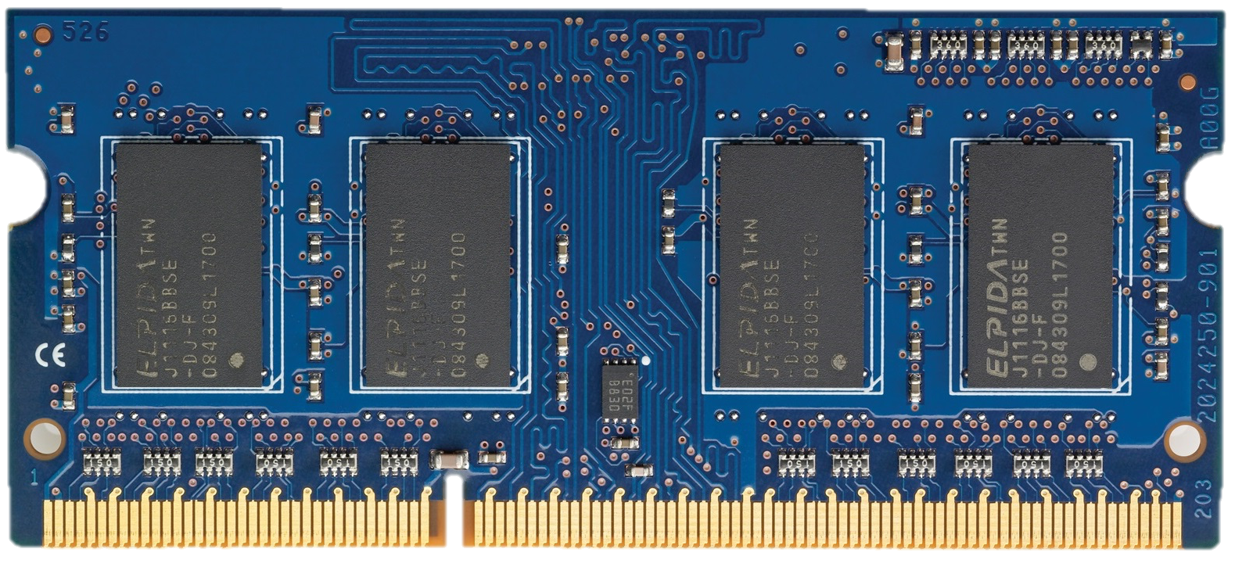
High-Level DRAM Organization
DRAM chips
DRAM
Channel
DRAM Module

Slide 10
DRAM Chip Internals
DRAM Cell
Bitline
Peripheral
Circuitry
DRAM
Array
Wordline
Control
Logic
Bank
S
S
S
S
I/O
Sense amplifiers
(row buffer)
Off-chip channel

Slide 11
DRAM Operations
1
ACTIVATE: Store the row
into the row buffer
1
1
1
1
2
READ: Select the target
cache line and drive to CPU
3
PRECHARGE: Prepare the array for a new ACTIVATE
to I/O

Slide 12
DRAM Access Latency
1
Activation latency
(13ns / 50 cycles)
2
Precharge latency
(13ns / 50 cycles)
Command
ACTIVATE
READ
PRECHARGE
Data
1
1
1
1
Cache line (64B)
Duration
Next
ACT

Slide 13
Outline
Executive Summary
Motivation
DRAM Background
Characterization of DRAM
  Experimental methodology
  Impact of voltage on reliability and latency
Voltron: DRAM Energy Reduction Mechanism
Conclusion

Slide 14
Supply Voltage Control on DRAM
DRAM Module
Supply Voltage
Adjust the supply voltage to every chip on the same module

Slide 15
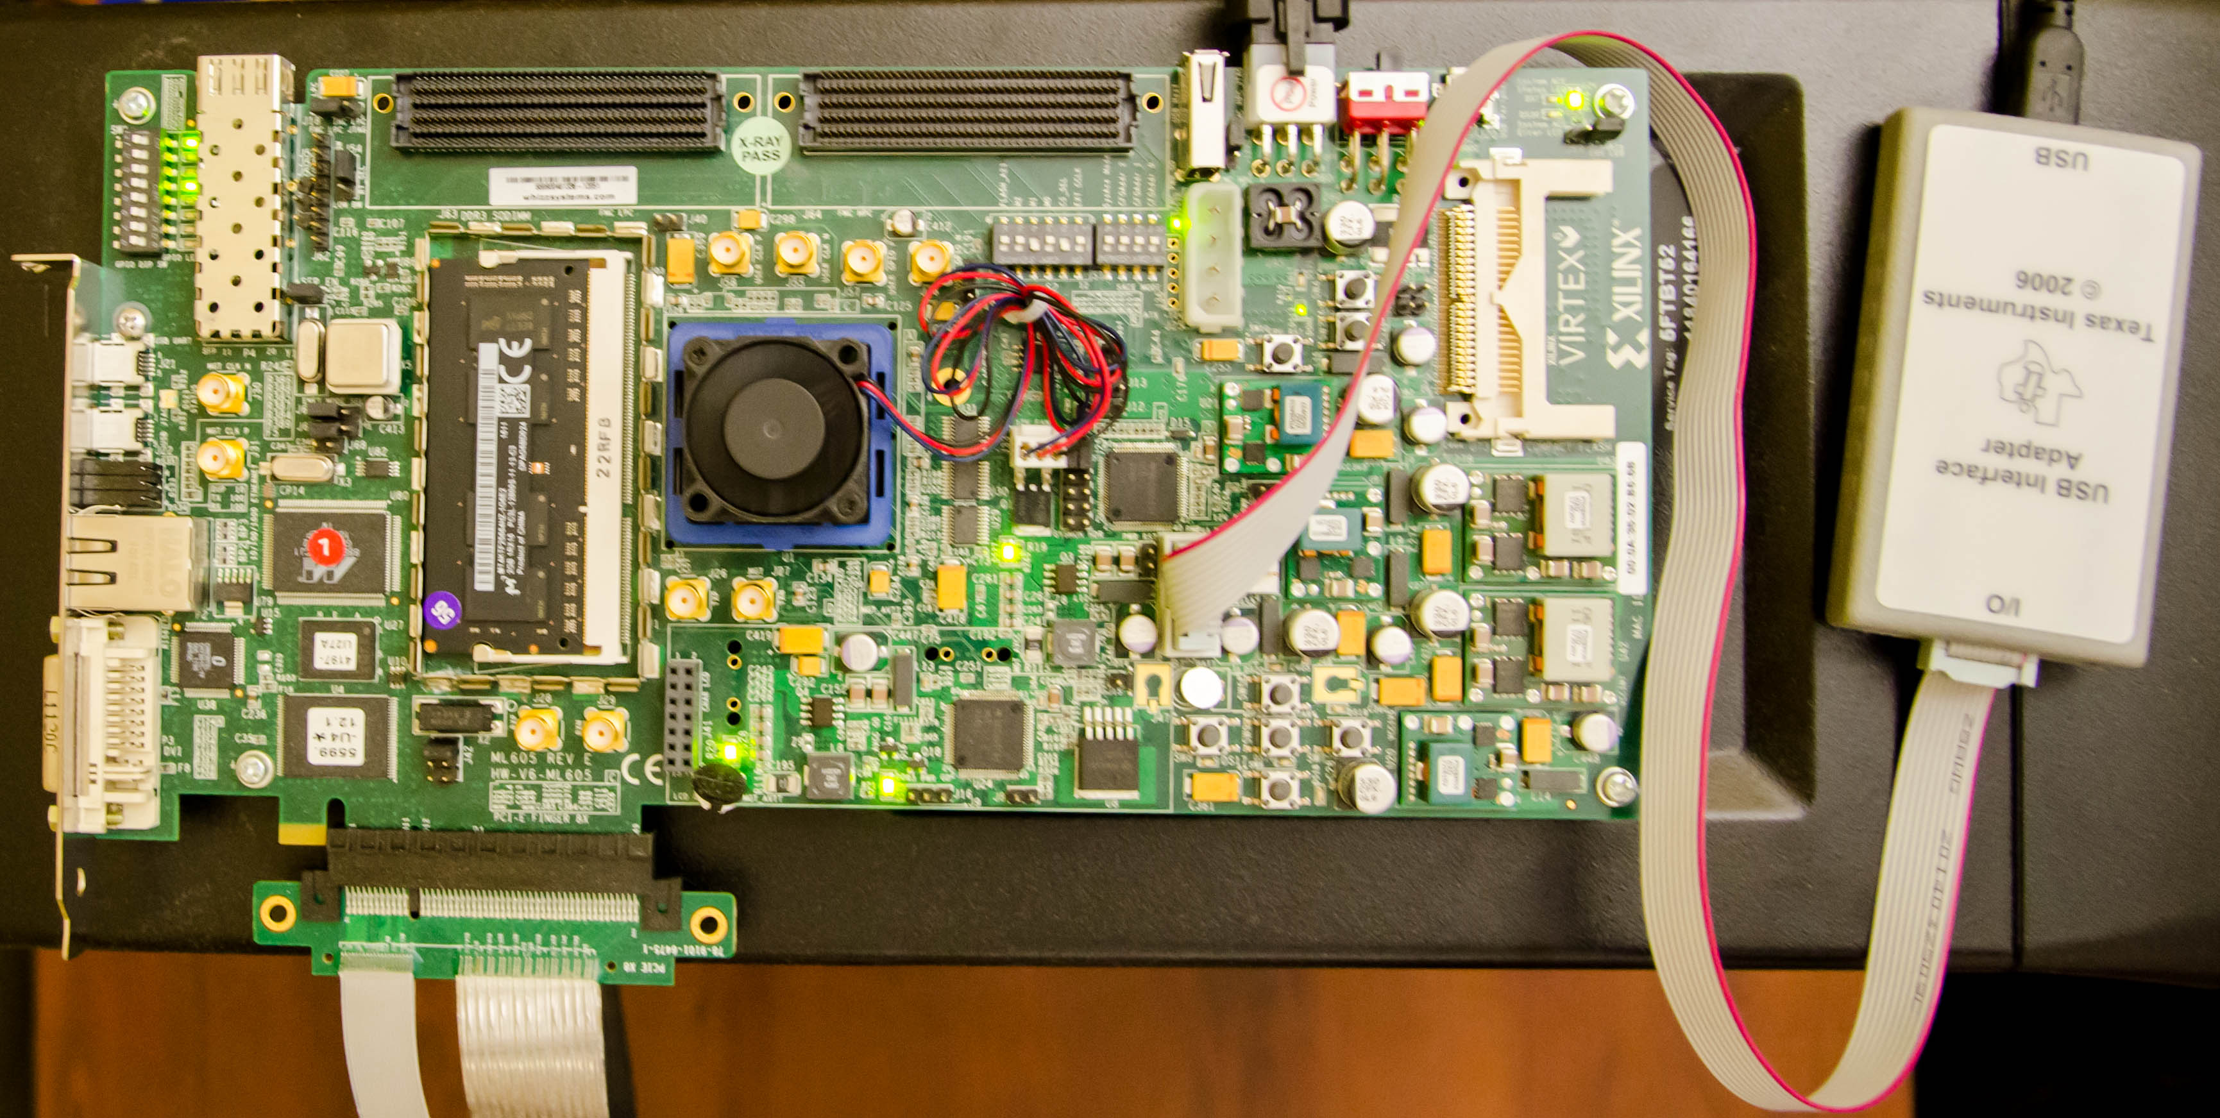
Custom Testing Platform
SoftMC [Hassan+, HPCA’17]: FPGA testing platform to
1) Adjust supply voltage to DRAM modules
2) Schedule DRAM commands to DRAM modules
  Existing systems: DRAM commands not exposed to users
DRAM
module
Voltage
controller
FPGA
https://github.com/CMU-SAFARI/DRAM-Voltage-Study

Slide 16
Tested DRAM Modules
124 DDR3L (low-voltage) DRAM chips
  31 SO-DIMMs
  1.35V (DDR3 uses 1.5V)
  Density: 4Gb per chip
  Three major vendors/manufacturers
  Manufacturing dates: 2014-2016
Iteratively read every bit in each 4Gb chip under a wide range of supply voltage levels: 1.35V to 1.0V (-26%)

Slide 17
Outline
Executive Summary
Motivation
DRAM Background
Characterization of DRAM
  Experimental methodology
  Impact of voltage on reliability and latency
Voltron: DRAM Energy Reduction Mechanism
Conclusion

Slide 18
Reliability Worsens with Lower Voltage
Errors induced by
reduced-voltage operation
Min. voltage (V_{min}) without errors
Nominal
Voltage
Reducing voltage below V_{min} causes
an increasing number of errors

Slide 19
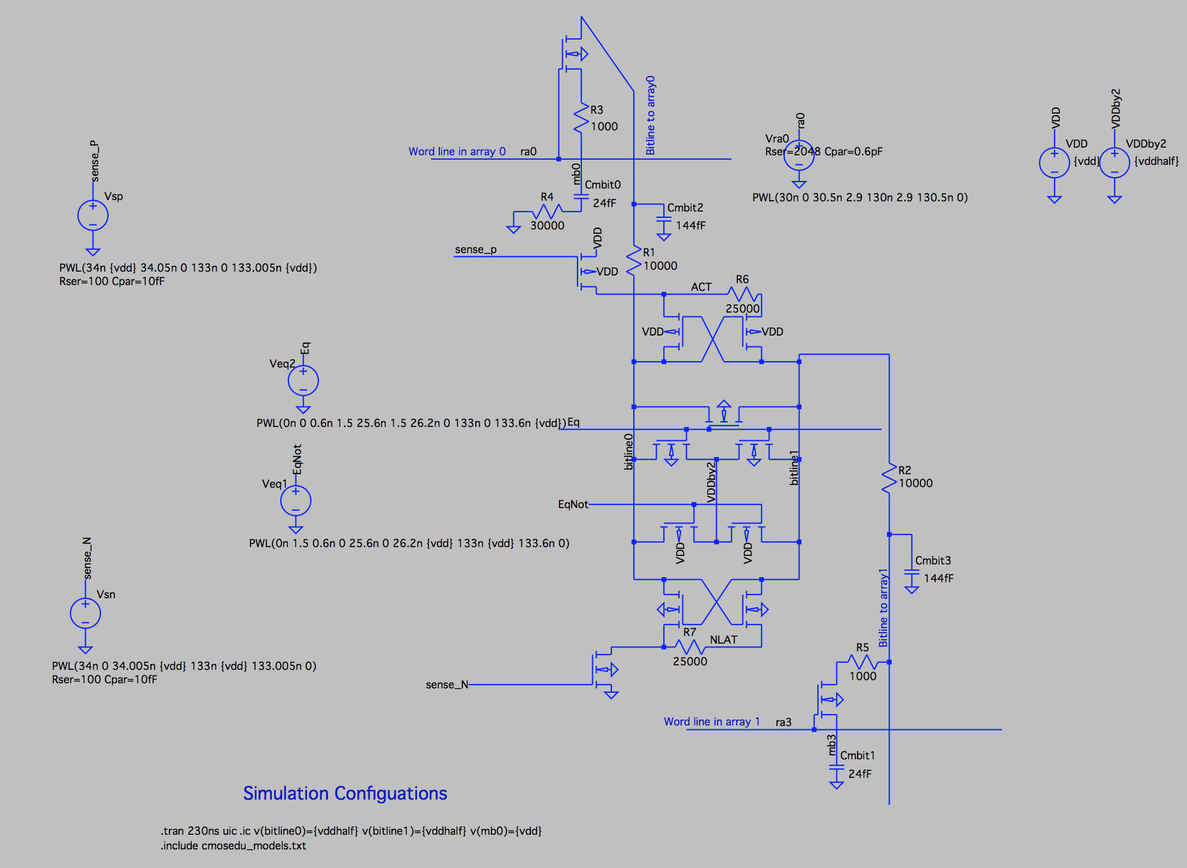
Source of Errors
Detailed circuit simulations (SPICE) of a DRAM cell array to model the behavior of DRAM operations
https://github.com/CMU-SAFARI/DRAM-Voltage-Study
Nominal
Voltage
Circuit model
Reliable low-voltage operation requires higher latency

Slide 20
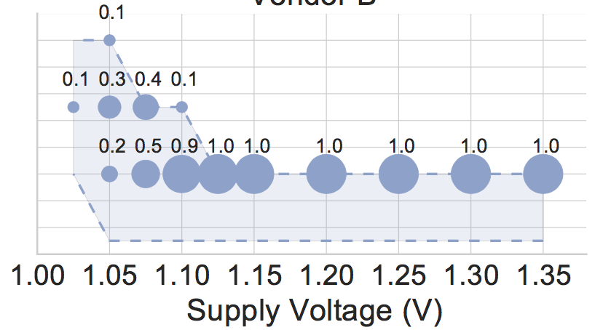
DIMMs Operating at Higher Latency
Measured minimum latency that does not cause errors in DRAM modules
40% of modules
14
Distribution of latency in the total population
100% of modules
Measured Minimum
Activate Latency (ns)
12
10
8
DRAM requires longer latency to access data without errors at lower voltage
Lower bound of latency as our latency adjustment granularity is 2.5ns

Slide 21
Spatial Locality of Errors
A module under 1.175V (12% voltage reduction)
Errors concentrate in certain regions

Slide 22
Other Results in the Paper
Error-Correcting Codes (ECC)
  ECC (SECDED) is not sufficient to mitigate the errors
Effect of temperature
  Higher temperature requires higher latency under some voltage levels
Data retention time
  Lower voltage does not require more frequent refreshes
Effect of stored data pattern on error rate
  Difference is not statistically significant to draw conclusion

Slide 23
Summary of Key Experimental Observations
Voltage-induced errors increase as
voltage reduces further below V_{min}
Errors exhibit spatial locality
Increasing the latency of DRAM operations mitigates voltage-induced errors

Slide 24
Outline
Executive Summary
Motivation
DRAM Background
Characterization of DRAM
  Experimental methodology
  Impact of voltage on reliability and latency
Voltron: DRAM Energy Reduction Mechanism
Conclusion

Slide 25
DRAM Voltage Adjustment to Reduce Energy
Goal: Exploit the trade-off between voltage and latency to reduce energy consumption
Approach: Reduce DRAM voltage reliably
  Performance loss due to increased latency at lower voltage
High Power Savings
Bad Performance
Low Power Savings
Good Performance

Slide 26
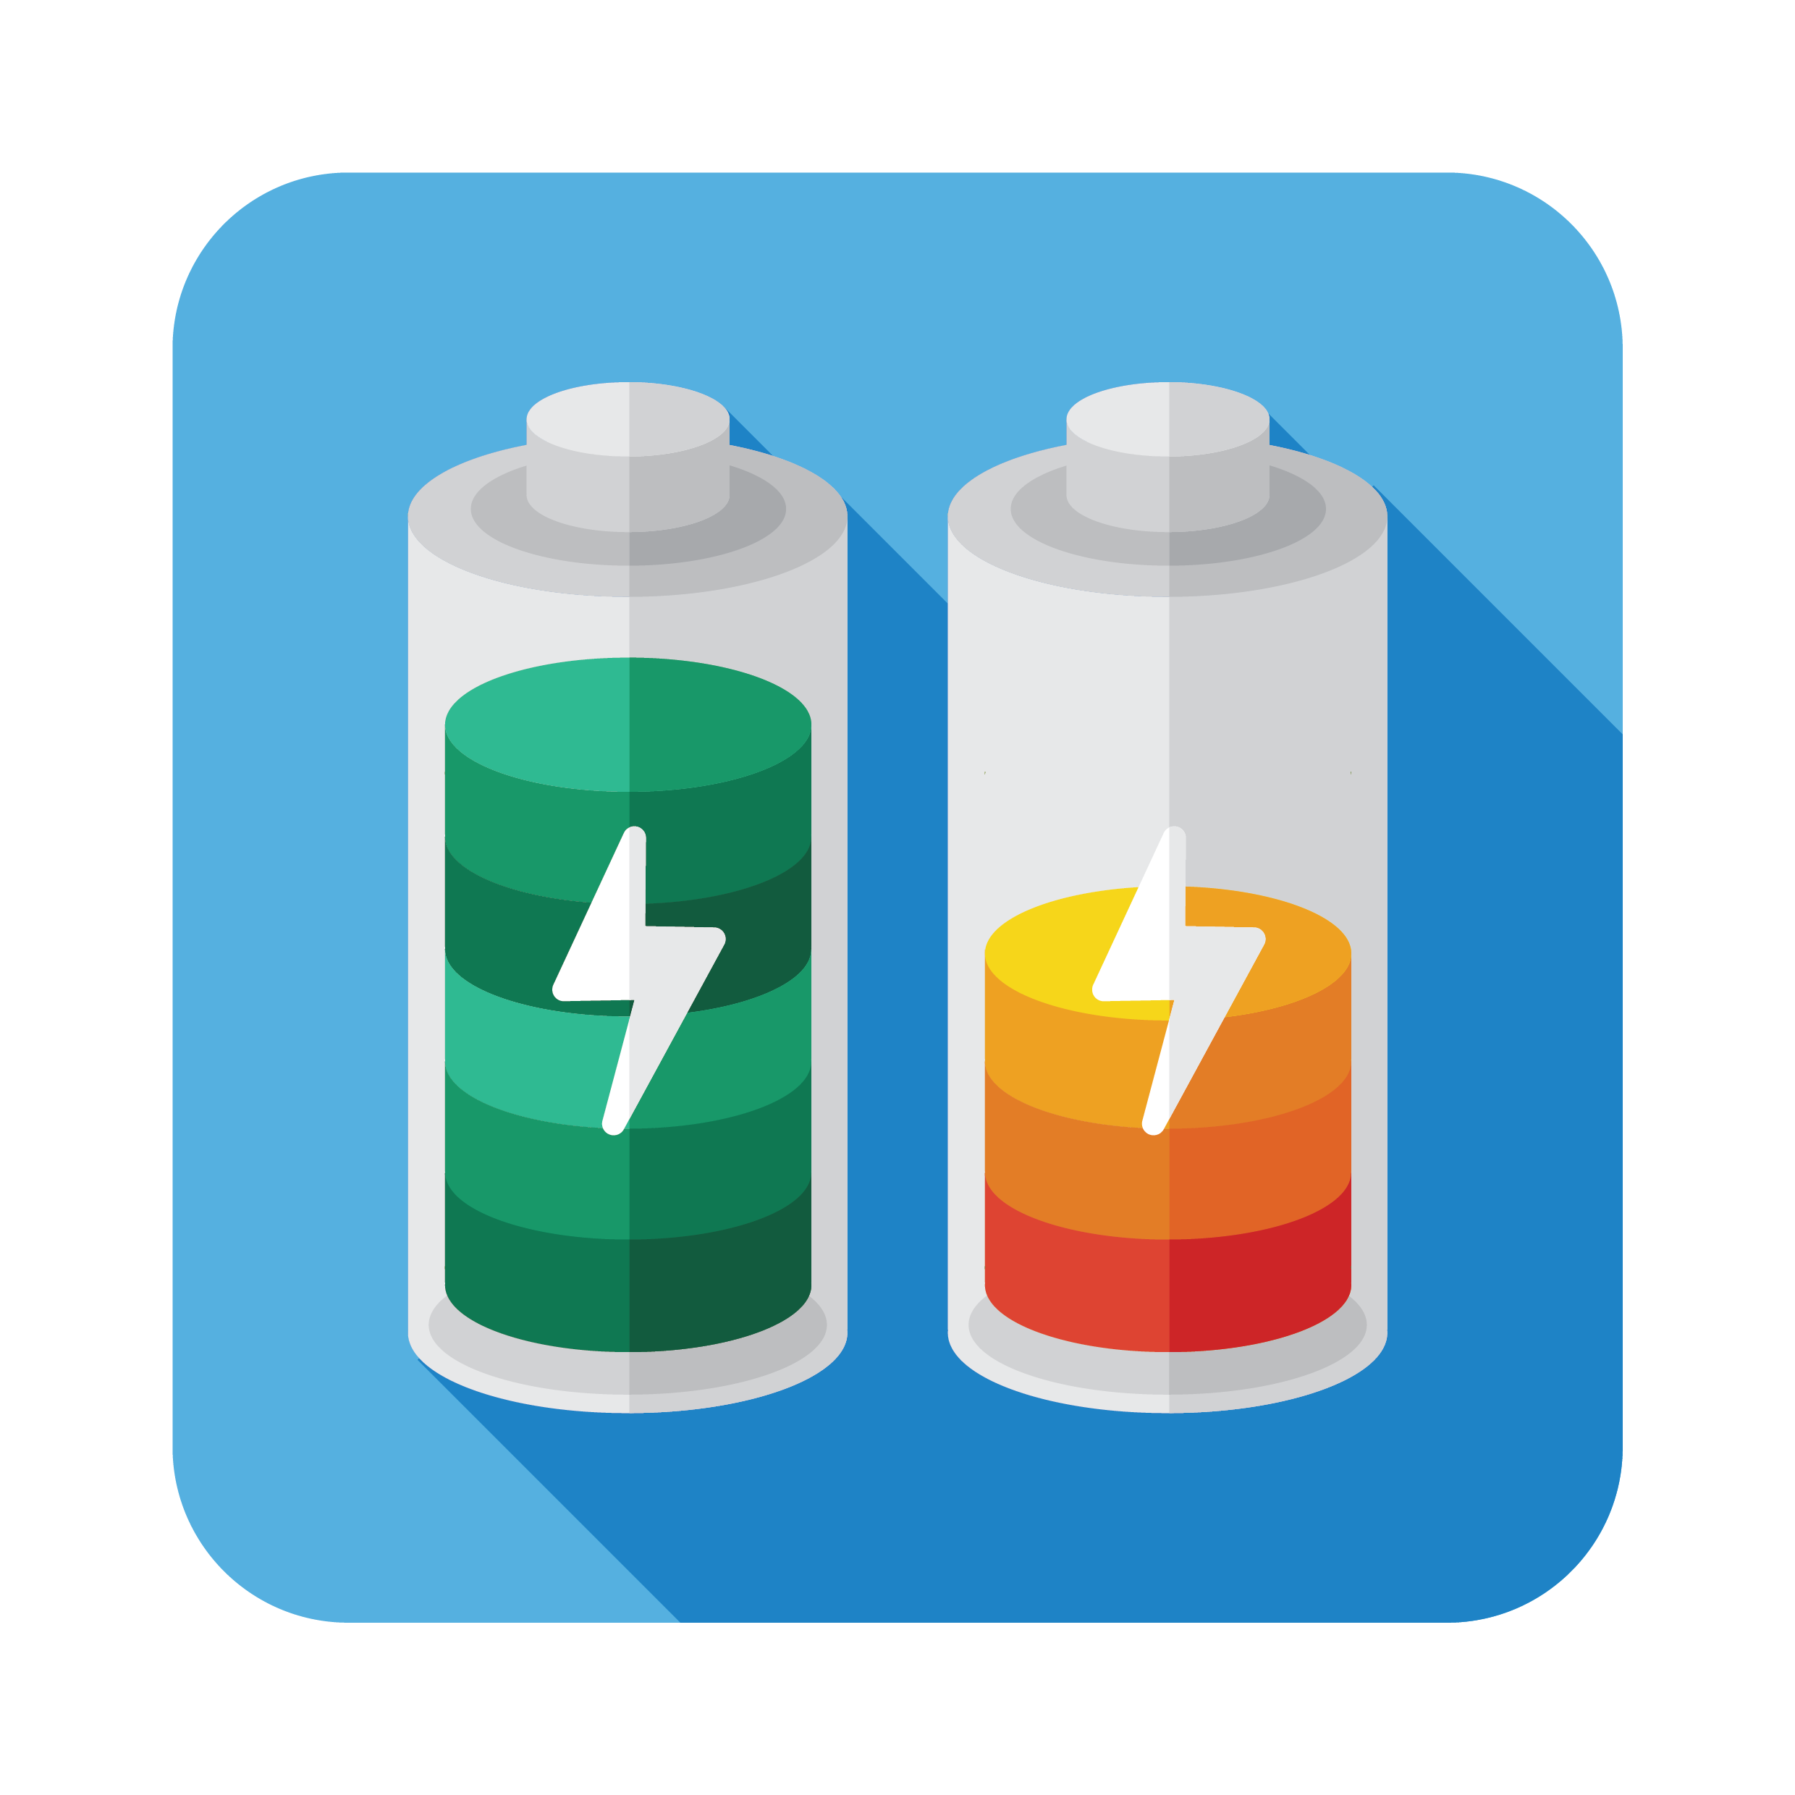


Voltron Overview
Voltron
User specifies the performance loss target
Select the minimum DRAM voltage without violating the target
How do we predict performance loss due to increased latency under low DRAM voltage?

Slide 27

Linear Model to Predict Performance
Voltron
User specifies the performance loss target
Select the minimum DRAM voltage without violating the target
Application’s characteristics
Min.
Voltage
Final
Voltage
[-1%, -3%, …]
Predicted performance loss
[1.3V, 1.25V, …]
Target
DRAM Voltage
Linear regression model

Slide 28
Linear Model to Predict Performance
Application’s characteristics for the model:
  Memory intensity: Frequency of last-level cache misses
  Memory stall time: Amount of time memory requests stall commit inside CPU
Handling multiple applications:
  Predict a performance loss for each application
  Select the minimum voltage that satisfies the performance target for all applications

Slide 29
Comparison to Prior Work
Prior work: Dynamically scale frequency and voltage of the entire DRAM based on bandwidth demand [David+, ICAC’11]
  Problem: Lowering voltage on the peripheral circuitry decreases channel frequency (memory data throughput)
Voltron: Reduce voltage to only DRAM array without changing the voltage to peripheral circuitry
Peripheral
Circuitry
DRAM
Array
Peripheral
Circuitry
DRAM
Array
Control
Logic
Control
Logic
Low Voltage
Low Voltage
Bank
Bank
I/O
I/O
Prior Work
Voltron
Off-chip channel
Off-chip channel
Low frequency
High frequency

Slide 30
Exploiting Spatial Locality of Errors
Key idea: Increase the latency only for DRAM banks that observe errors under low voltage
  Benefit: Higher performance
Peripheral
Circuitry
DRAM Array
Control
Logic
Bank 0
Bank 1
Bank 2
I/O
Off-chip channel
High latency
Low latency

Slide 31
Outline
Executive Summary
Motivation
DRAM Background
Characterization of DRAM
  Experimental methodology
  Impact of voltage on reliability and latency
Voltron: DRAM Energy Reduction Mechanism
  Evaluation
Conclusion

Slide 32
Voltron Evaluation Methodology
Cycle-level simulator: Ramulator [CAL’15]
  McPAT and DRAMPower for energy measurement
4-core system with DDR3L memory
Benchmarks: SPEC2006, YCSB
Comparison to prior work: MemDVFS [David+, ICAC’11]
  Dynamic DRAM frequency and voltage scaling
  Scaling based on the memory bandwidth consumption
https://github.com/CMU-SAFARI/ramulator

Slide 33
Energy Savings with Bounded Performance
[David+, ICAC’11]
Meets performance target
7.3%
More savings for
high bandwidth applications
-1.6%
-1.8%
3.2%
1. Voltron improves energy for both low and high intensity workloads
Performance Target
2. Voltron satisfies the performance loss target via a regression model

Slide 34
Outline
Executive Summary
Motivation
DRAM Background
Characterization of DRAM
  Experimental methodology
  Impact of voltage on reliability and latency
Voltron: DRAM Energy Reduction Mechanism
Conclusion

Slide 35
Conclusion
DRAM (memory) power is significant in today’s systems
  Existing low-voltage DRAM reduces voltage conservatively
Goal: Understand and exploit the reliability and latency behavior of real DRAM chips under aggressive reduced-voltage operation
Key experimental observations:
  Errors occur and increase with lower voltage
  Errors exhibit spatial locality
  Higher operation latency mitigates voltage-induced errors
Voltron: A new DRAM energy reduction mechanism
  Reduce DRAM voltage without introducing errors
  Use a regression model to select voltage that does not degrade performance beyond a chosen target → 7.3% system energy reduction

Slide 36
Understanding Reduced-Voltage Operation in Modern DRAM Devices
Experimental Characterization, Analysis, and Mechanisms
Kevin Chang†
A. Giray Yaglikci†, Saugata Ghose†, Aditya Agrawal*, Niladrish Chatterjee*,
Abhijith Kashyap†, Donghyuk Lee*, Mike O’Connor*, Hasan Hassan‡, Onur Mutlu†‡
†
*
‡

Slide 37
BACKUP

Slide 38
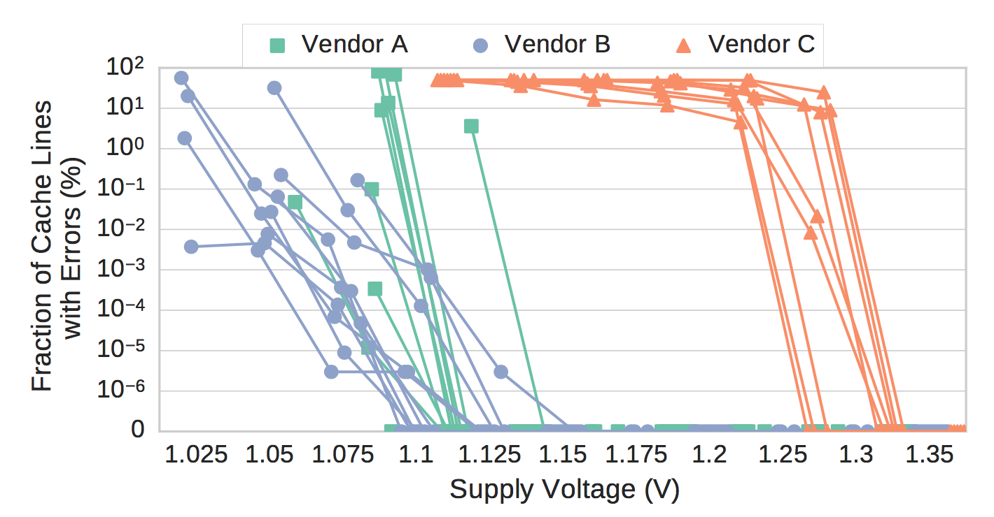
Errors Rates Across Modules

Slide 39
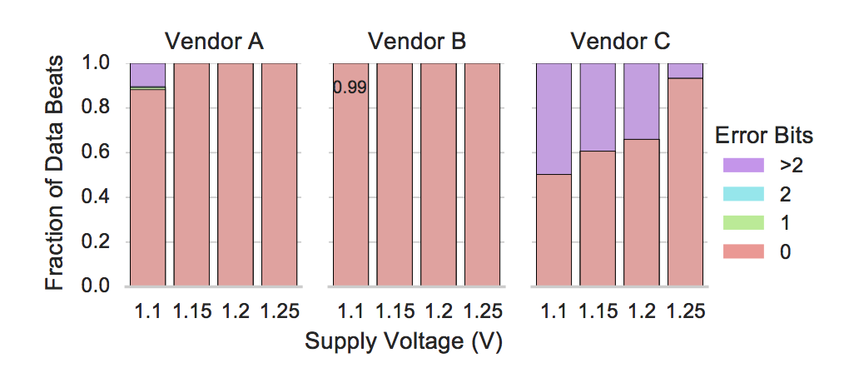
Error Density

Slide 40
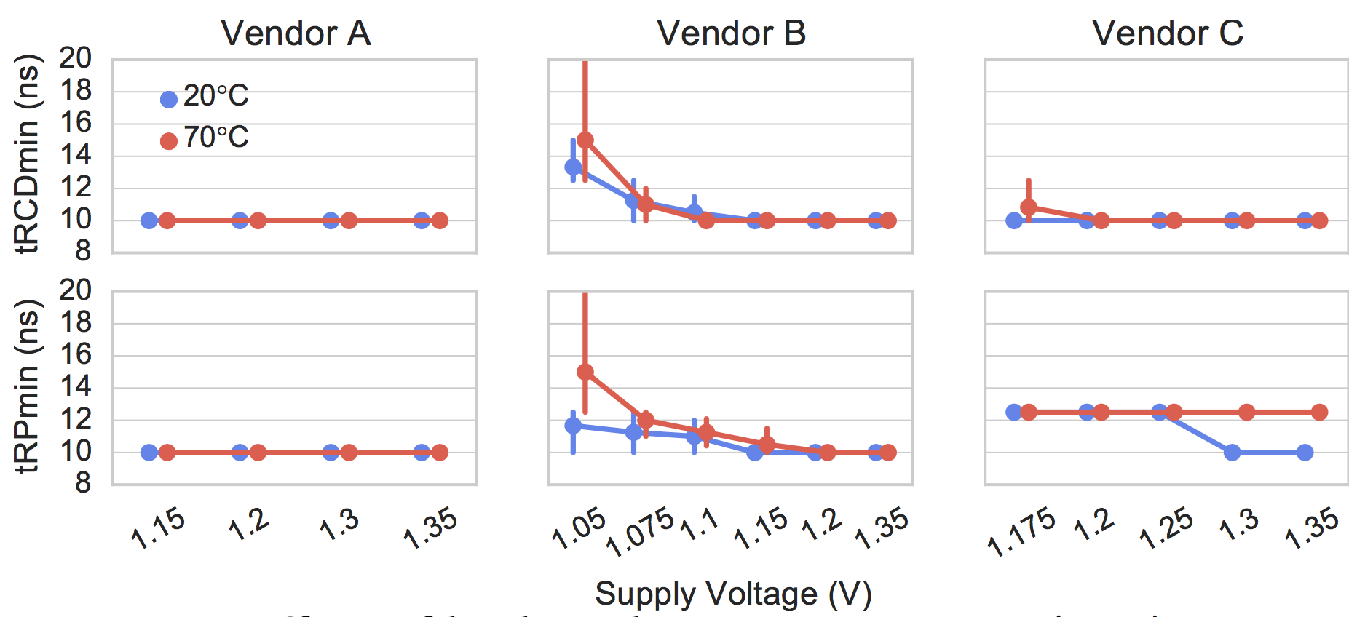
Temperature Impact

Slide 41
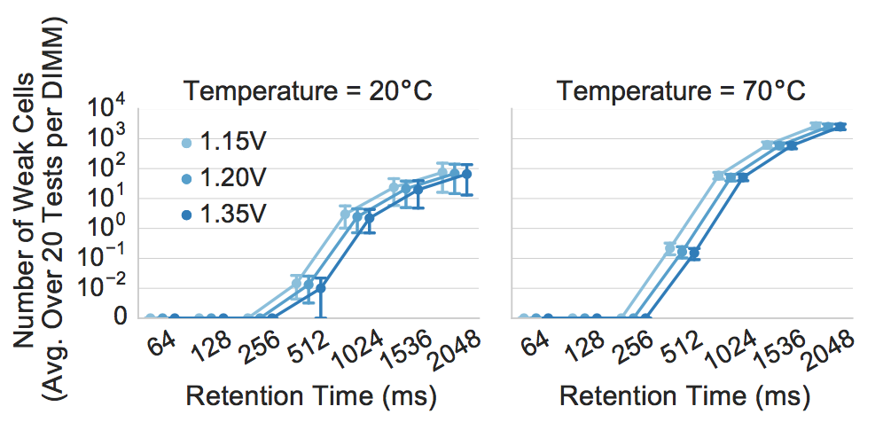
Impact on Retention Time

Slide 42
Derivation of More Precise Latency
Circuit-level SPICE simulation
Potential latency range
DRAM circuit model validates our experimental results and provides more precise latency

Slide 43
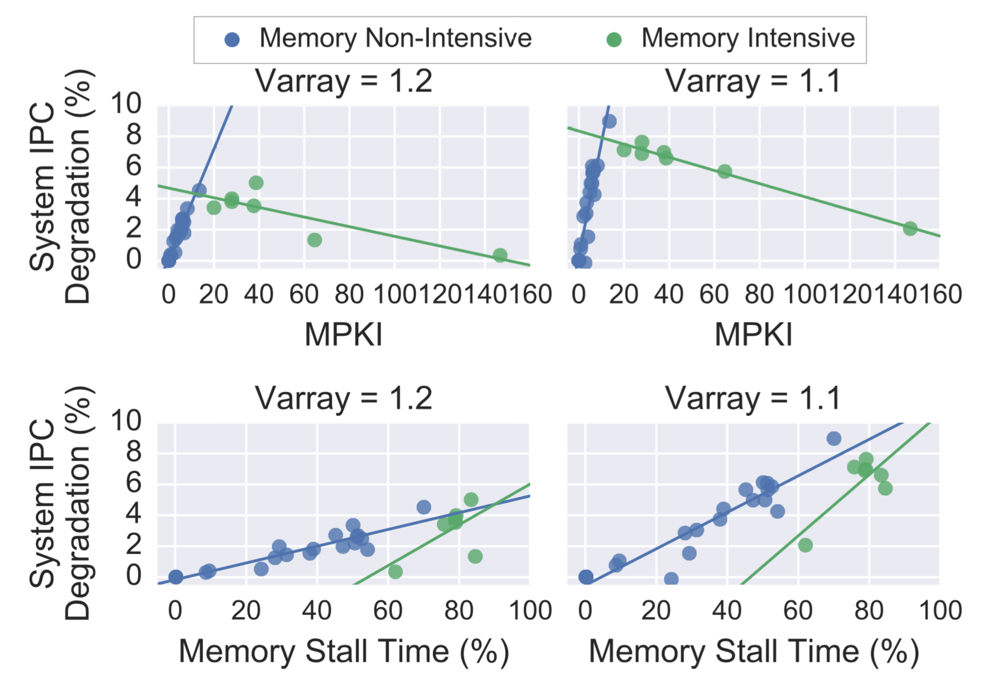
Performance Loss Correlation
Observation: Application’s performance loss due to higher latency has a strong linear relationship with its memory intensity
Voltage = 1.2V (-13%)
Voltage = 1.1V (-23%)
DRAM Latency +5%
DRAM Latency +13%
Performance
Degradation (%)
Memory Intensity (MPKI)
Memory Intensity (MPKI)
MPKI = Last-level cache Misses Per Thousand Instruction

Slide 44
Performance-Aware Voltage Adjustment
Build a performance (linear-regression) model to predict performance loss based on the selected voltage
𝜽s are trained through 151 application samples
Use the model to select a minimum voltage that satisfies a performance loss target specified by the user
$${PredictedLoss=θ}_{0}+θ_{1}Latency+θ_{2}App.Itensity+θ_{3}App.StallTime$$
Latency due to voltage adjustment
The running application’s characteristics
Notes:
Given this observation, we build a performance model to predict perf…
With this model, there are different ways to make a decision on how to select a voltage.
For example, if the user specifies a 5% loss target for Voltron, Voltron would iteratively go through different voltage levels and select the minimum that it predict would not incur a performance loss greater than the target
Our policy is to select the minimum voltage that does not exceed a performance loss target specified by the user.

Slide 45
Linear Model Accuracy
R² = 0.75 / 0.9 for low and high intensity workloads
RMSE = 2.8 / 2.5 for low and high intensity workloads

Slide 46
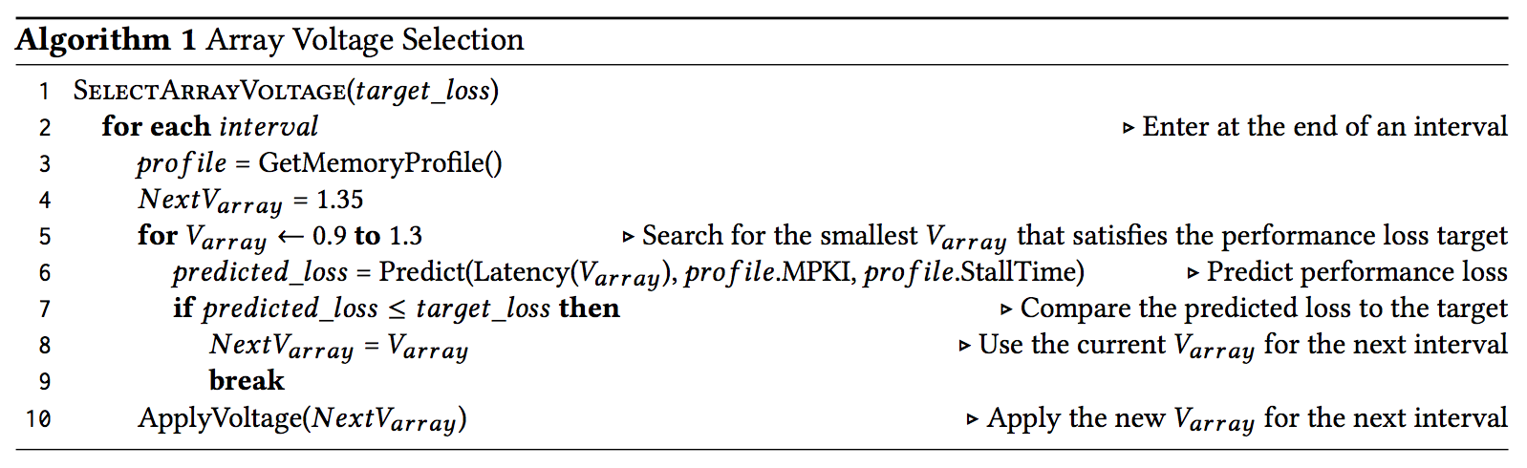
Dynamic Voltron

Slide 47
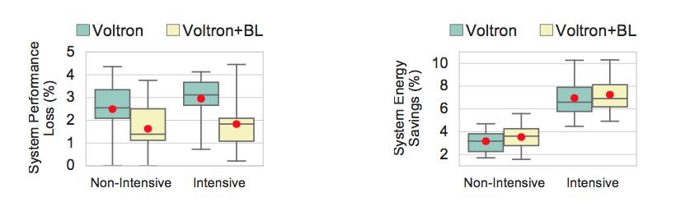
Effect of Exploiting Error Locality

Slide 48
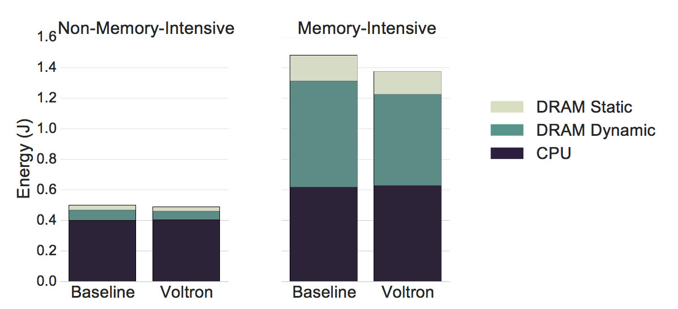
Energy Breakdown

Slide 49
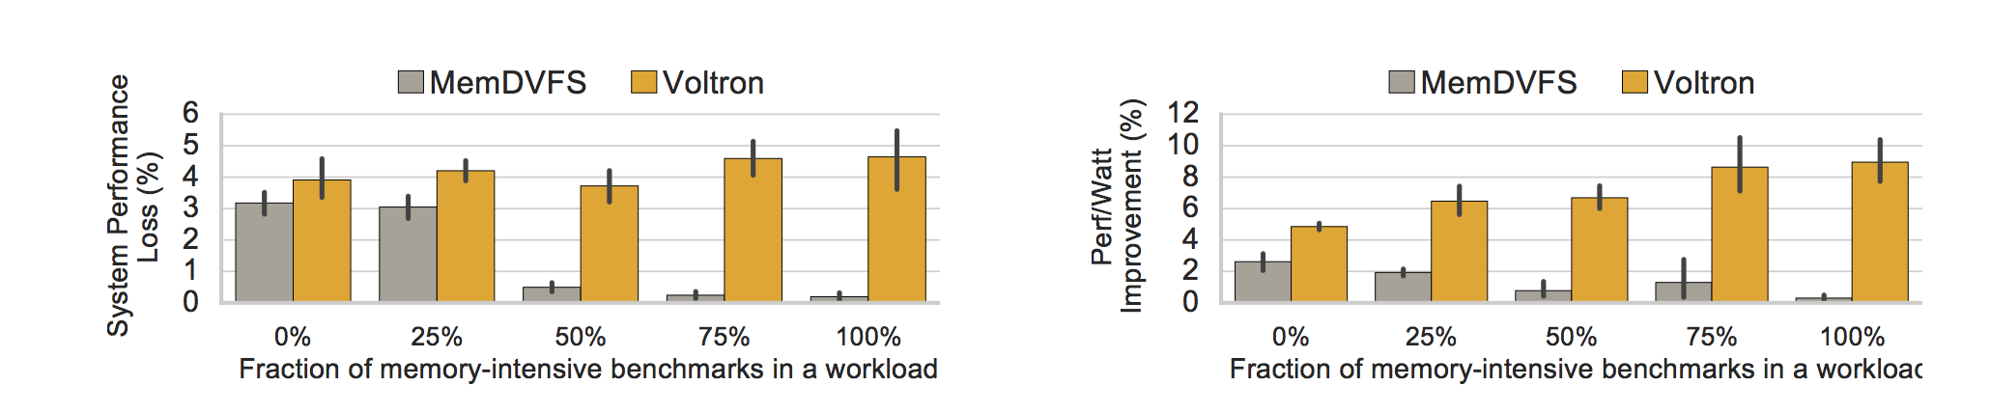
Heterogeneous Workloads

Slide 50
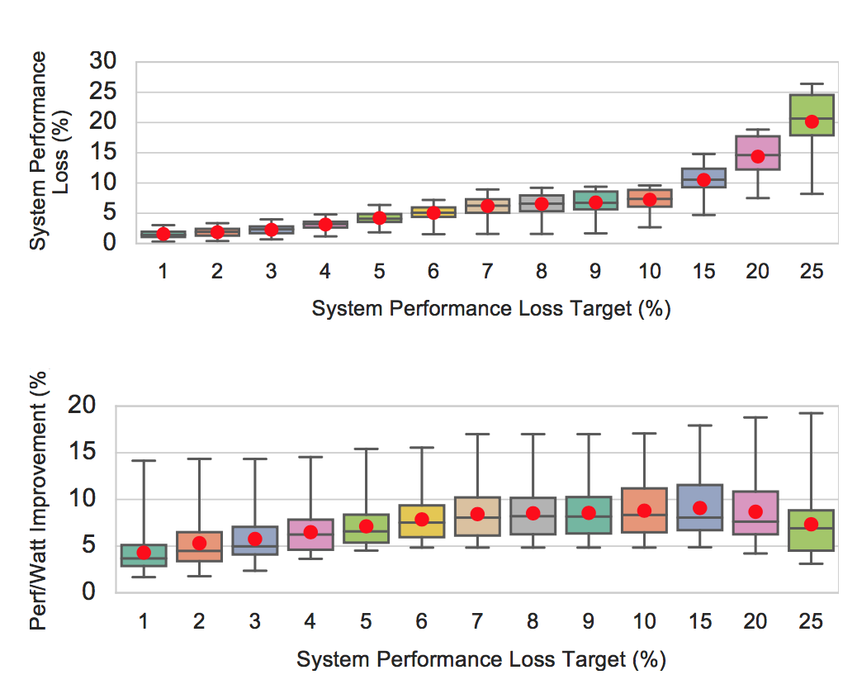
Performance Target Sweep

Slide 51
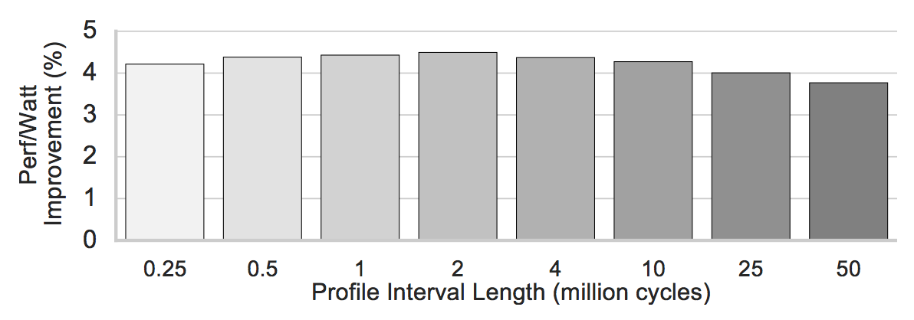
Sensitivity to Profile Interval Length

